Slide 1
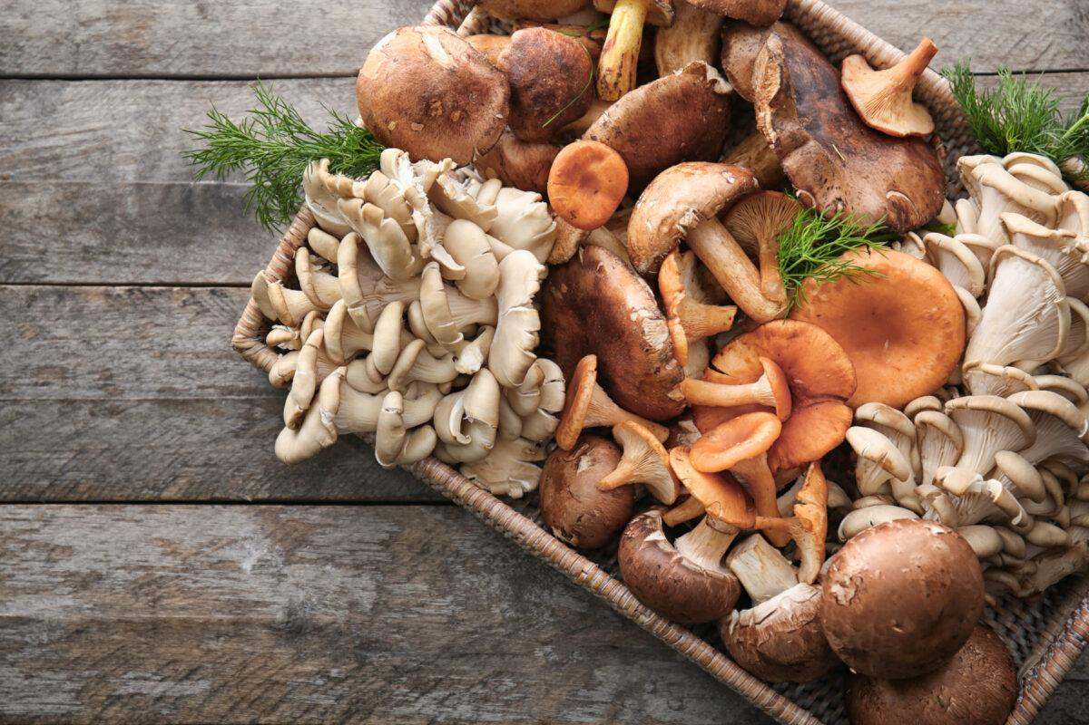
To Eat, or Not to Eat?
Identifying whether mushrooms are edible or poisonous
Sakshi and Abbie | LaunchCode Women+, Data Science | March 9, 2022
Notes:
Abbie

Slide 2
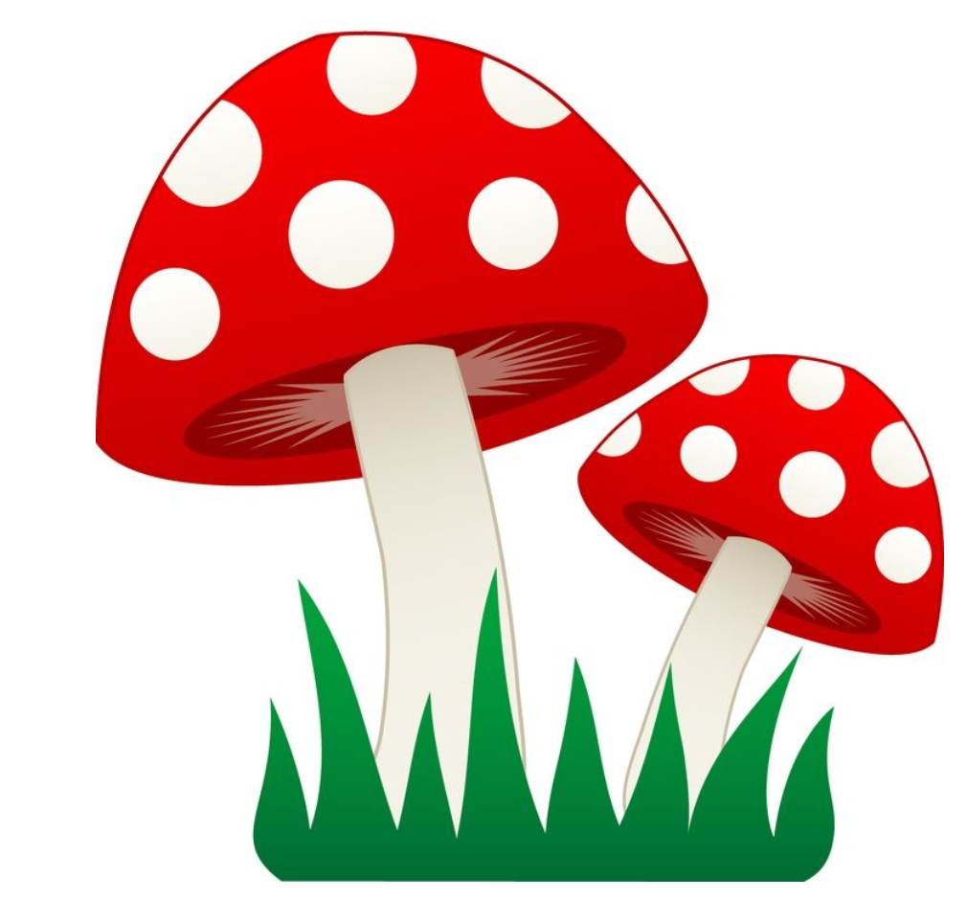
Scope of problem
There are millions of mushroom species (estimated 5M-6M)
Mushroom foraging is rising in popularity
Many mushrooms are toxic💀
7428/year ingest poisonous mushrooms with minor harm
39/year experience major harm
2.9/year die from ingestion
Notes:
Abbie
Source: https://pubmed.ncbi.nlm.nih.gov/30062915/#:~:text=Approximately%20704%20(39%2Fyear),ingested%20by%20older%20adults%20unintentionally.

Slide 3
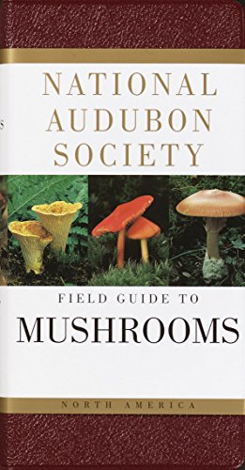
Our data source
UCI Machine Learning Repository
Data retrieved from The Audubon Society Field Guide to North American Mushrooms, published in 1981
Notes:
Abbie
Source: https://pubmed.ncbi.nlm.nih.gov/30062915/#:~:text=Approximately%20704%20(39%2Fyear),ingested%20by%20older%20adults%20unintentionally.

Slide 4
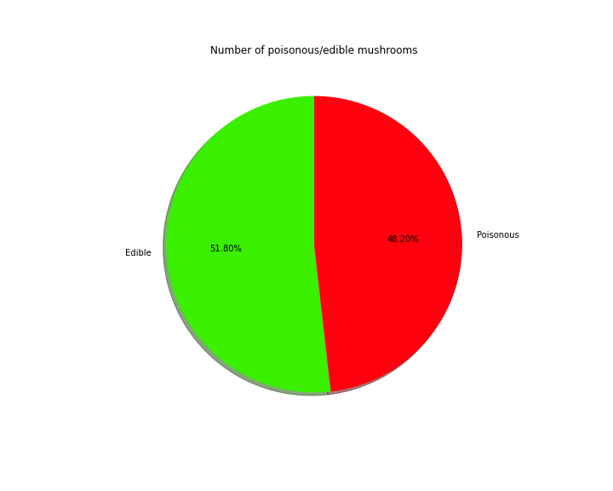
Mushroom Dataset
22 Attributes: (Explained in detail in next slide)
Class Attribute: Edible(e) or Poisonous(p)
Dataset Characteristics | Multivariate | Number of Instances | 8124
Attribute Characteristics | Categorical | Number of Attributes | 22
Notes:
Abbie

Slide 5
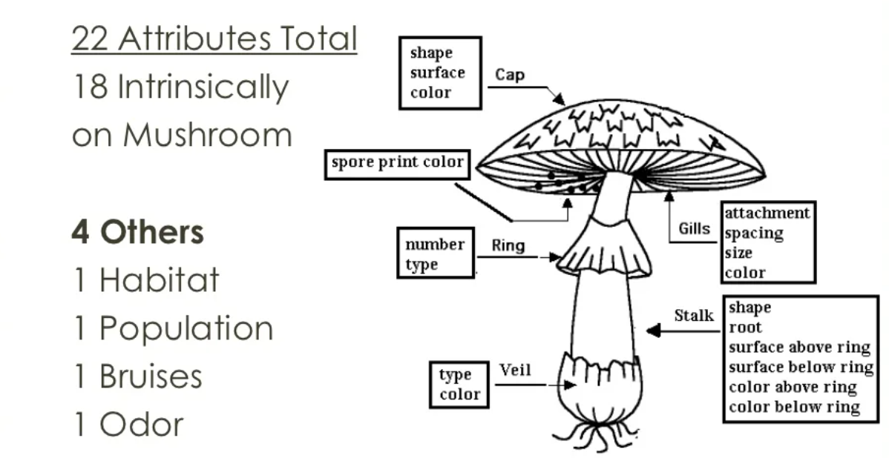
Dataset Attribute Information
Notes:
Abbie

Slide 6
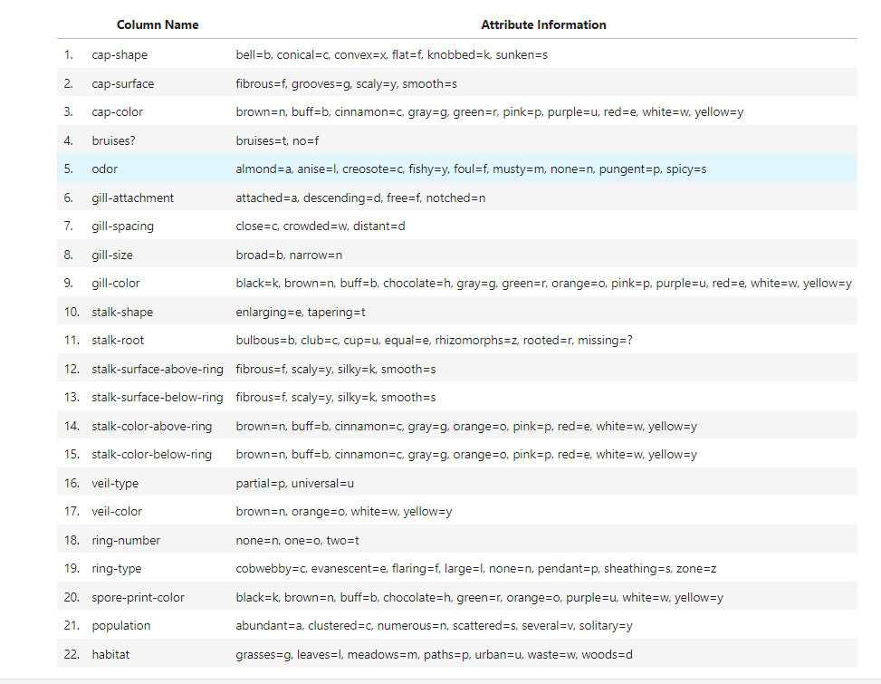
Dataset Attribute Information

Slide 7
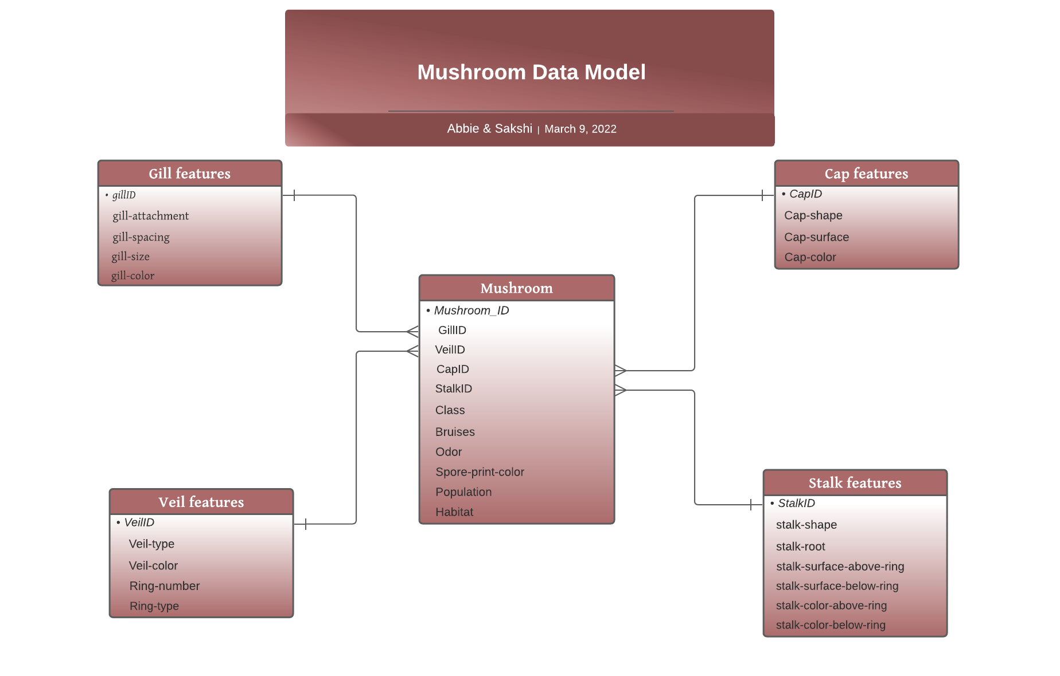
Notes:
Abbie

Slide 8
ETL Journey and Learning
Preprocessing:
All the feature names had ‘-’ which was replaced by ‘_’.
Created unique identifier for each table by sum of row values.
For feature attribute tables like Gill, Cap, Veil & Stalk dropped duplicate rows
Ran DML statements to create database, tables and load data.
Learning from queries:
In which habitat are the edible mushrooms found mostly? Woods/Grass
How odor helps classify mushrooms as edible or not? No vs foul smell
How does gill color determine edibility of mushrooms? Buff color with odor is mostly poisonous
What is the class breakdown for a scattered population? Mostly edible mushrooms are found in scattered population
Notes:
Sakshi
Because the presentation is intended to focus heavily on the models, I think we can actually remove this slide! We can simply discuss our data model

Slide 9
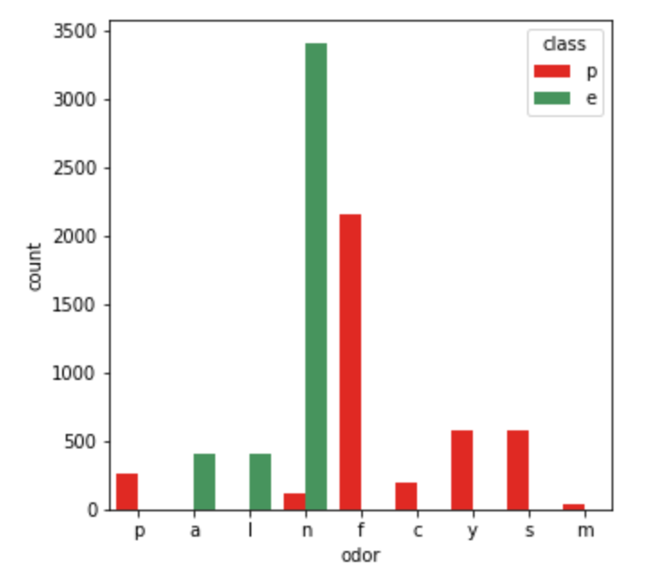
Exploratory Data analysis
Viewed initial relationships among variables and determined possible re-categorization (e.g “bad” smell and “not bad” smell)
Notes:
Sakshi

Slide 10

Simple pre-processing
Removed the "stalk-root" variable (too many missing values)
Converted all variables to numerical
Explored all attributes with count plot to understand category distribution.
Implemented appropriate feature engineering Wherever possible re-coded categories under 2 or 3 major types. Eg:(Odor, gill-color & spore-print-color)
Standardized the variables
Determining the relevant features...
Notes:
Sakshi

Slide 11
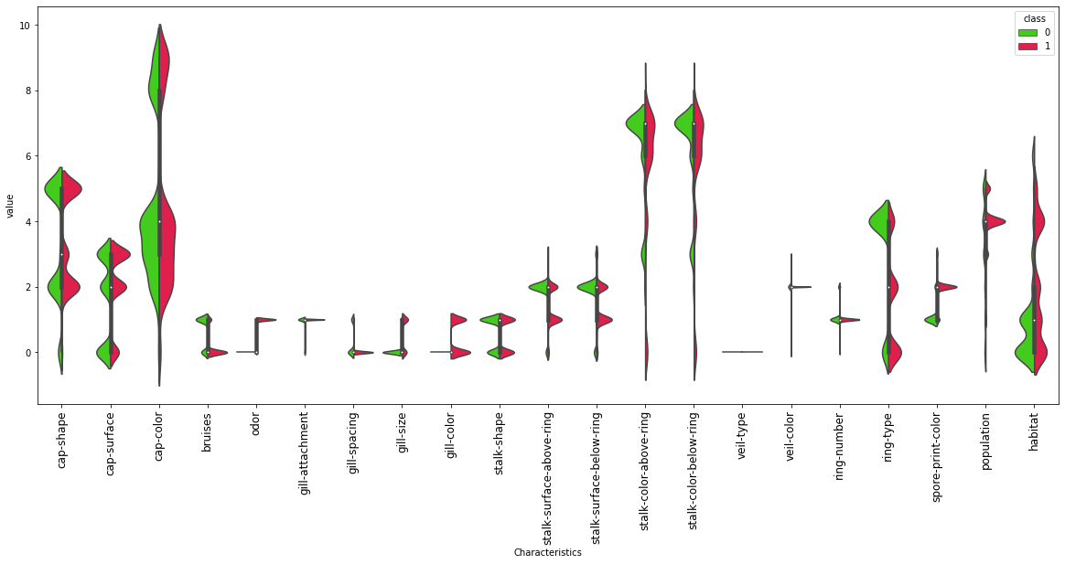
Determine Important Features
Notes:
Sakshi

Slide 12
Fun with Functions
Before we move on the Data modelling, we want to highlight the fun we had with functions!
def label_encode(df)
def violin(df, dependent_var)
def tri_corr_matrix(df)
def countplot(x_var, df)
def create_uid(df)
def evaluate_model(y_test, y_pred, y_pred_prob)
def optimal_threshold(X_test, y_test)
and many more..
Notes:
Sakshi

Slide 13
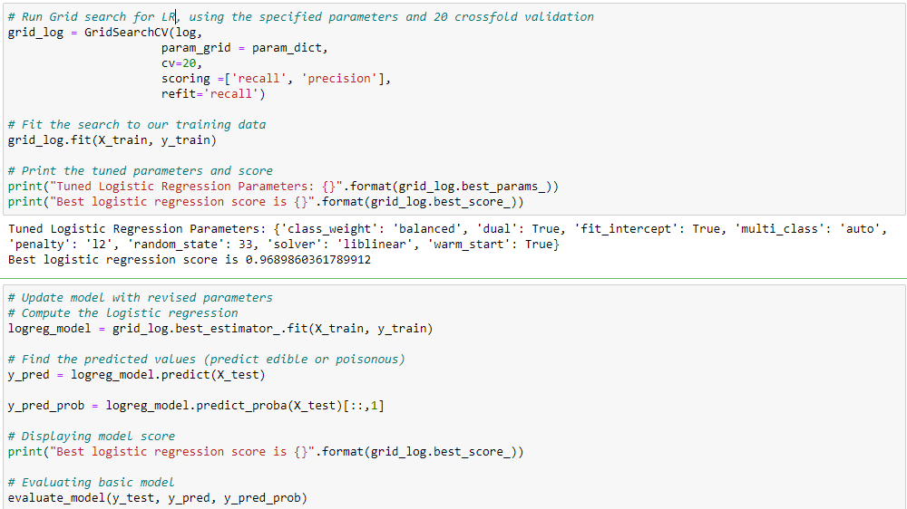
Data Model 1: Logistic Regression
Notes:
Abbie

Slide 14
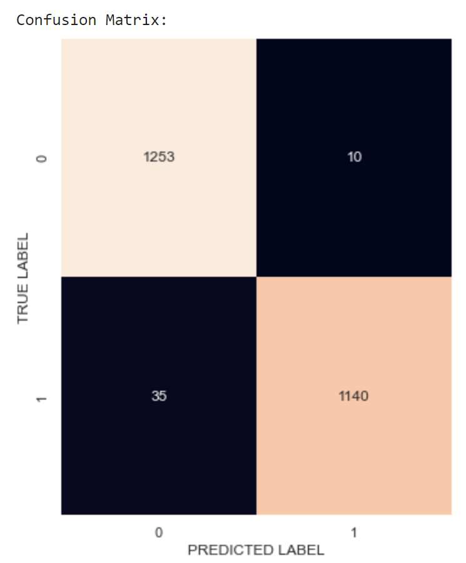
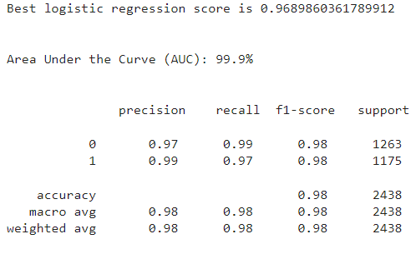
Data Model 1: Logistic Regression
Notes:
Abbie

Slide 15
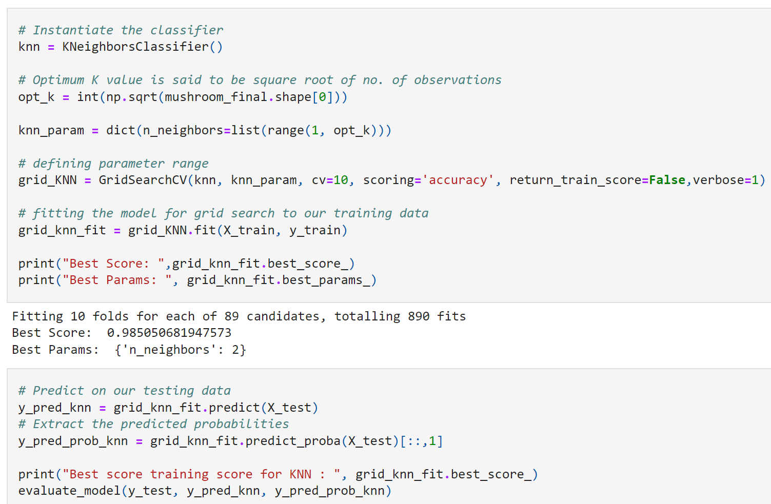
Data Model 2 : KNN Classifier Model
Notes:
Sakshi

Slide 16
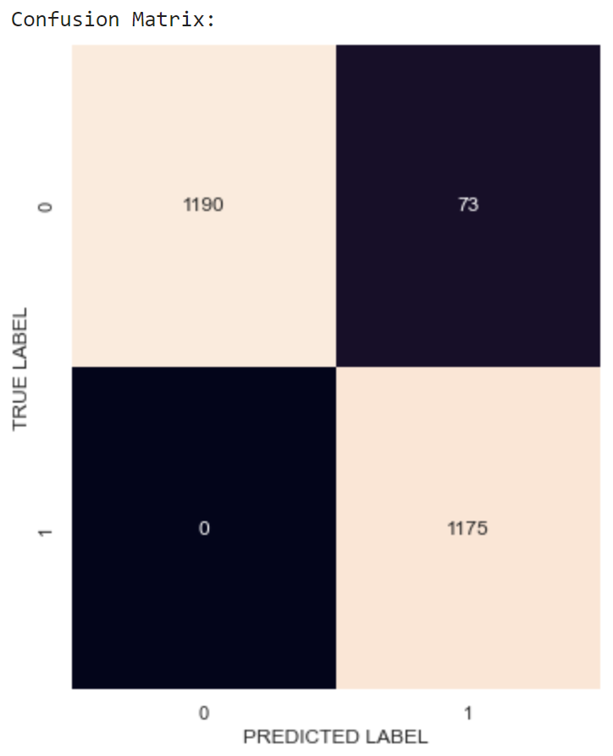
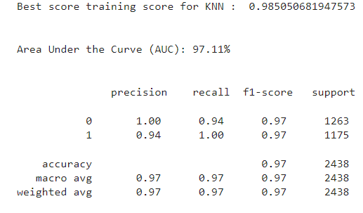
Data Model 2 : KNN Classifier Model
Notes:
Sakshi

Slide 17
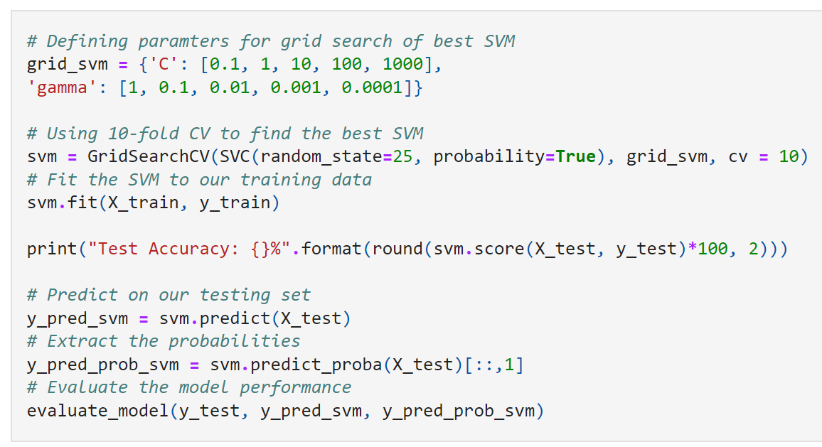
Data Model 3: Support vector Machine Classification Model
Notes:
Sakshi

Slide 18

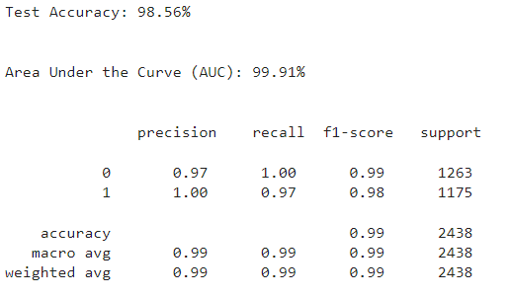
Data Model 3: Support vector Machine Classification Model
Notes:
Sakshi

Slide 19
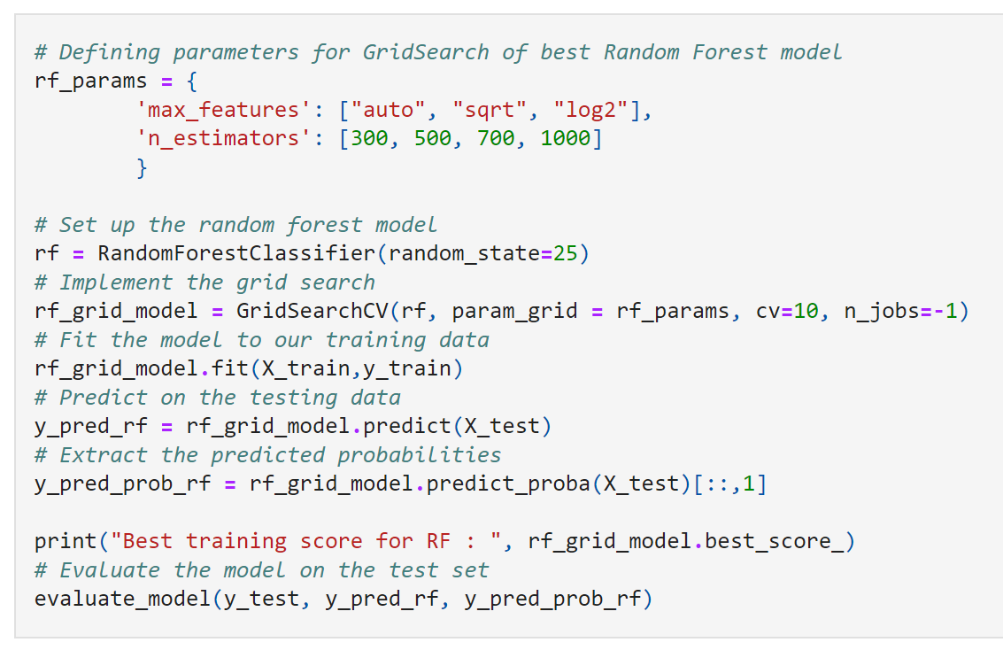
Data Models 4: Random Forest Classification model
Notes:
Abbie

Slide 20
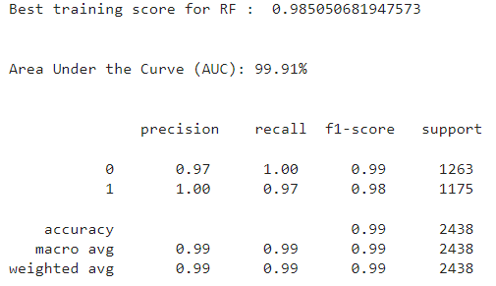
Data Models 4: Random Forest Classification model
Notes:
Abbie

Slide 21
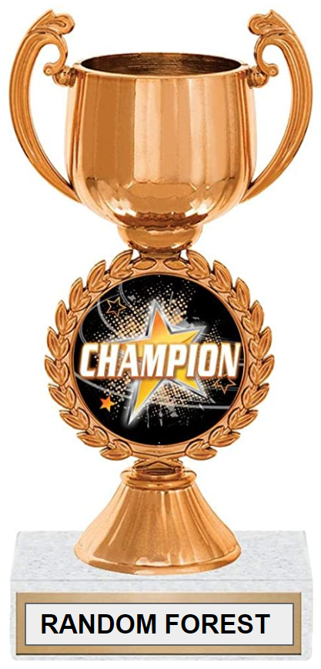
Which Model was best?
Random Forest
Best overall accuracy score
Best AUC score
While tied with KNN on scoring, ensemble methods are more robust against over-fitting
Notes:
Abbie

Slide 22
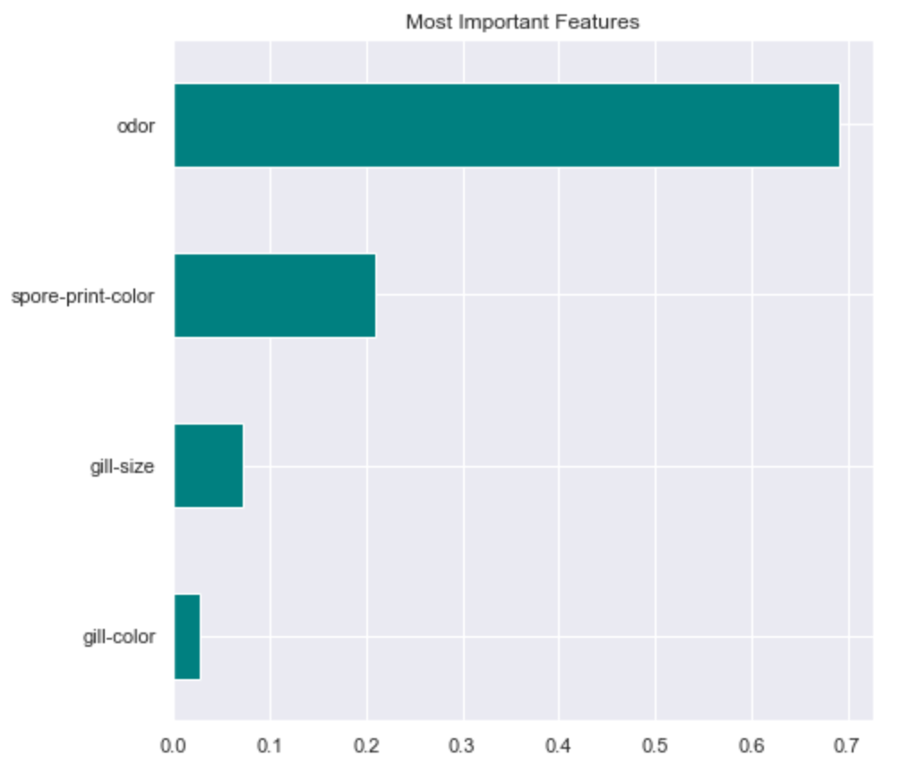
Conclusions and final thoughts
Odor is very informative in predicting whether a mushroom is poisonous or edible.
In the dataset 2.7% of mushrooms with no odor were classified as poisonous. Hence other attributed help us with decisive classification.
Notes:
Abbie

Slide 23
Conclusions and final thoughts (cont.)
Exploratory analysis can help you discover predictive variables
It can be beneficial to regroup categorical variables into smaller categories
Sometimes, different models will have very similar scoring, if the individual variables are highly predictive
Notes:
Sakshi

Slide 24
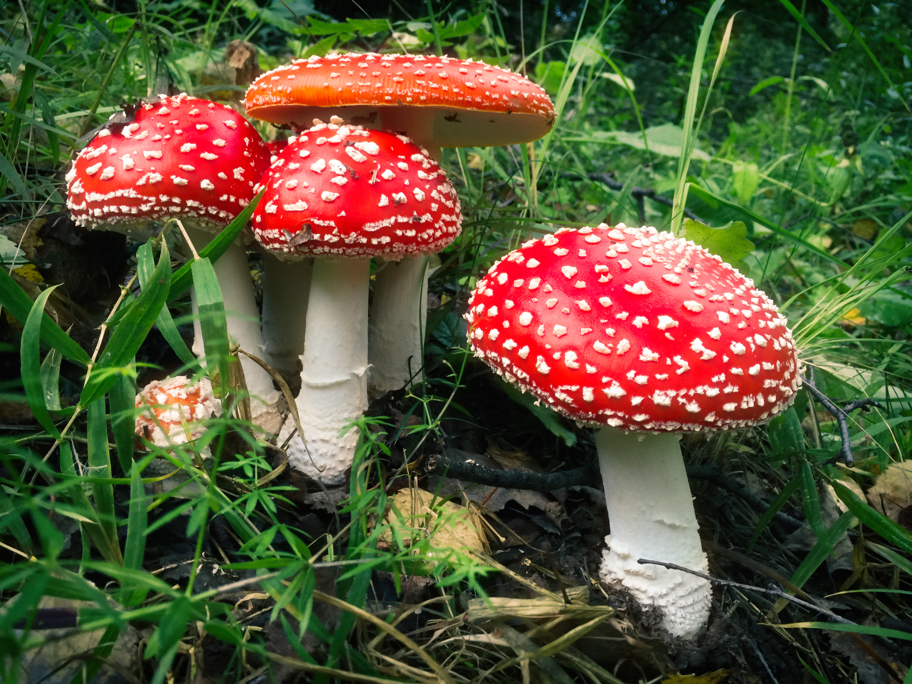
Happy foraging!!
Notes:
Sakshi

